Slide 1

Annual Title I Parent Meeting
Let’s dive into learning, family engagement, and
student success!
WELCOME, FAMILIES!

Slide 2
Welcome & Meeting Goals
Purpose of tonight’s meeting:
Federal guidelines require Title I schools to hold an Annual Meeting to explain and discuss Title I programs and requirements.

Slide 3

What Is Title I?
Title I is :
The largest federal assistance program for our nation’s schools
The goal of Title 1 is a higher-quality education for every child
The program serves millions of children in elementary and secondary schools. MCS is a Title 1 school
The federal government provides funding for several programs and staff members at our school. Title 1 dollars provide intervention materials and staff to implement them. Title 1 also provides funds for staff training, before and after school programs, parent involvement activities, and internet-based intervention programs. Marion Charter School uses a school-wide program so all children benefit.

Slide 4
Qualifying for Title I
Eligibility is based on the percentage of students eligible to receive free or reduced-price meals
Must be supplemental to District funds
Required to set aside a minimum amount for Family Engagement
Parents are stakeholders in determining how Parent Engagement funds are to be used

Slide 5
Title I Funds
Title I Parent and Family Engagement Funds
  Amount of funds available for this year:
  $___69,825.00_____
  Parent and Engagement Allocation: $926.00
  We use our Title I funds to help pay the salaries of our Paraprofessionals who work closely with all of our students in the areas of reading, math, writing, science, and social studies, as well as purchasing Student Planners for our 3rd-5th Graders.

Slide 6
Parent Rights
You have the right to:
Be involved and request regular meetings to share your concerns and opinions
Be provided with information on your child’s level of achievement on assessments like FSA in all core subjects
Request and receive information on the qualifications of your child’s teacher
Be informed if your child is taught by a teacher who is not highly qualified teacher for 4 or more consecutive weeks. ALL MCS teachers are highly qualified for the subjects they are teaching.

Slide 7

School Accountability and School Grade
The School Accountability Report Card provides parents and the community with important information about each public school. This information is available in our office, is linked to our website, and is available online at https://www.fldoe.org/accountability/accountability-reporting/school-grades/
Our School Grade and AYP information is available at http://schoolgrades.fldoe.org/default.asp.
We are currently an “A” school this year based on last year’s testing scores.
year’s testing scores.

Slide 8
Florida B.E.S.T. Standards and Next Generation Sunshine State Standards
Florida B.E.S.T. Standards and Next Generation Sunshine State Standards identify what your child needs to know and be able to do in all content areas at all grade levels. This information is located at: http://www.floridastandards.org/Standards/FLStandardSearch.aspx.
year’s testing scores.

Slide 9

State Standards Assessments
Florida Assessment of Student Achievement(FAST) is used to measure student achievement of the BEST State Standards.
FAST Writing is used to measure a student’s ability to respond effectively to a writing prompt.
Statewide Science Assessment (SSA) is used to measure student achievement of the Next Generation Sunshine State Standards.
  ELA FAST-Grades K-5 (3 times a year)
  Math FAST-Grades K-5 (3 times a year)
  FAST Writing- Grades 4th and 5th
  NGSS Science-5th Grade
year’s testing scores.

Slide 10

Local Assessments
Assessments are used to help teachers determine if a student is understanding the content presented in the classroom.
We use the following assessments for all of our students:
  I-Ready
  FAST Assessments for ELA and Math
  DPMA (District Progress Monitoring)
  Classroom Benchmark tests
year’s testing scores.

Slide 11
Curriculum Overview
Classroom instruction is based on the expectations identified in the Florida State Standards.
We use the following curricula to meet the needs of our students:
  ELA: Benchmark Universe
  Math: Savvas Envision!
  Science: K-2-McGraw Hill
  3rd-5th- Houghton Mifflin Harcourt
  Social Studies: Analytic Orange
  We also use other supplemental programs such as I-Ready, IXL, Reading Rangers, Reflex Math and Frax, Corrective Reading, Read Naturally, Lalilo, Mystery Science, Generation Genius, and ESGI for Kdg.

Slide 12
MCS and Parent/Family Partners
The Title 1 law requires that all Title 1 schools and families work together. How we work together is listed in our School Level Parental Involvement Policy, our Parent-School compact, and our School Improvement Plan.
We ask for parent input through our annual Title I Surveys that happen twice a year.
MCS provides opportunities for parents to volunteer their time and talents throughout the school year.
MCS offers parent workshops, trainings, parent/teacher conferences, and the opportunity to visit the Family Resource Center downtown.
Our School Improvement Plan can be viewed at- www.marioncharter.org

Slide 13
School Improvement Plan
Referred to as the SIP
Outlines a school's efforts to enhance academic achievement and address systemic challenges by setting specific, measurable goals and detailing the actions, strategies, and timelines needed to achieve them.
A SIP is a dynamic, living document, often developed with input from the entire school community, that uses data to identify areas needing improvement, such as student performance, and provides a roadmap for continuous improvement to foster a more effective learning environment and support student success.

Slide 14
Parent/Family Engagement Plan
Referred to as the PFEP.
Describes how the school will carry out the parental engagement requirements.
Developed jointly with parents through annual Title I surveys.
A written summary of the PFEP is available to parents on our school website.

Slide 15
Parent/Family Engagement Plan
Each Title I school must have a School-Parent Compact that is written by parents and school personnel.
The Parent/Teacher/Student Compact lists the school’s responsibilities and promises; the family’s responsibilities and promises; and the student’s responsibilities and promises.
At the elementary level, the compact is shared during our first parent-teacher report card conferences.
The compact is to be reviewed and signed each year by stakeholders (teachers, students, and parents)

Slide 16
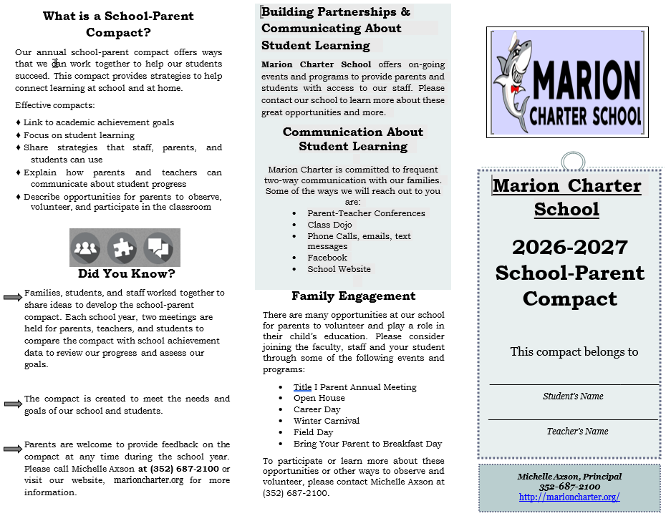

Slide 17
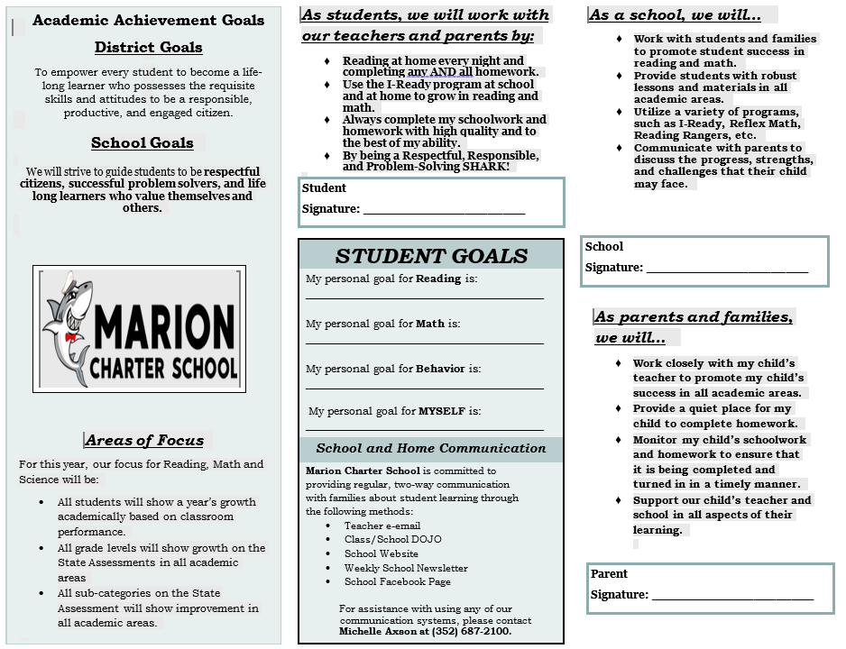

Slide 18

Communication is VITAL!
To provide parents with the most flexibility, our teachers are available to meet with parents, by appointment, at their discretion. Regular school meeting times are from 7:30-3:15, unless a different time is set up by the teacher.
We communicate with you via our weekly school newsletters. All newsletters are posted on the school website as well as our DOJO page. Our website is full of school information and resources. You can check out the various resources at www.marioncharter.org We also have DOJO and our Facebook page as other tools for communication with our parents and families.
PLEASE communicate with your child’s teacher if you have questions or concerns, or if there are any changes at home that may affect your child’s day at school.

Slide 19
Grading Periods and Conferences
This year we will have (4) 9 week grading periods.
To help you understand how your child is doing, we hold 2 parent conference meetings each year. These meetings are held at the 1st and 3rd report card periods. Report cards are handed out at these meetings; they are not sent home.
For the second and final 9-week periods, report cards will be sent home and conferences will be held for families who request them.
All parents at MCS are asked to meet with their child’s teacher at least for those 2 conferences.
In addition to the report cards/conferences, we send home interim reports to let you know how your child is progressing in school.
You can check your child’s grades in Skyward regularly to monitor your child’s progress.

Slide 20

Parent Engagement
Research shows that no matter the socio-economic status, when parents are engaged, students are more likely to:
attend school regularly
earn better grades
obtain better test scores
be promoted to the next grade
adapt to change
have better social skills
graduate
continue their education

Slide 21
Some Ways You Can Help Your Child
Take advantage of the books and materials at the public library and our school library
Show interest in your child’s school day- ask questions, ask to see homework, check their daily folders
Encourage good study habits
Share a love of learning
Read to your child and ask your child to read to you
Limit TV and video game time
Support your child’s teacher by not talking negatively about them in front of your child
Praise their efforts
If your child wears glasses, make sure they have them. If you need help getting or replacing glasses, please contact the school. Your child can’t learn if they cannot see correctly.
Become knowledgeable about the Sunshine State Standards and what your child needs to know
Regular on-time attendance is important. Your child needs to be in school on time to get the most out of school. Attendance letters will be sent home every 20 days for students whose attendance rate has dropped below 80%. Follow-up meetings will be held with parents whose children continue to have excessive absences.

Slide 22
Academic Parent Trainings
In compliance with the Parent and Family Engagement Plan, we would like to invite you to attend our upcoming parent trainings:
Dr. Seuss Literacy Night!
Come celebrate Dr. Seuss’s birthday and do some reading activities as a family.— this will be held in March
5th Grade Parent Information Session
Here 5th grade students and parents will learn about the expectations, requirements, and curriculum for 6th grade and middle school.—
Publix Math Night!
Come to Publix and do a fun scavenger hunt while solving math problems.— this will be held in January.

Slide 23
In Review
Your involvement is crucial to your child’s success.
Research shows that your influence and involvement are vital to your child’s success.
You are your child’s first teacher and the constant leader in your home.
You set the tone and make decisions about what is important in your home.
We are here to help you help your child.
Please make time to speak with us about your child, and never hesitate to set a meeting to share any concerns or ask questions.
Let us know how we can help you help your child.

Slide 24
Conclusion
Thank you for attending tonight’s Title I Annual Parent Meeting.
Take a moment to complete the Parent Survey at the back of your packet and turn it in the basket at the front of the room.
Thank you for your attendance, participation, and feedback.
We look forward to a successful school year!
THANK YOU FOR DIVING IN WITH US! 🦈

